Slide 1
Monolith Architecture
=> Developing all functionalities in single application.
1) Presentation Layer
2) Business Layer
3) Data Access Layer
=> Drawbacks with Monolith Architecture
1) Burden on Server
2) Response Delay
3) Server can crash
4) Single Point of failure
5)Technology dependent
=> To overcome problems of Monolith Architecture, developers are using Microservices Architecture.
Microservices
=> It is not a technology
=> It is not a framework
=> It is not an API
=> It is an architectural design pattern

Slide 2
=> It is universal and anyone can use this architecture to develop applications.
Note: Divide & Conquer Principle
Advantages with Microservices
1) Loosely Coupled
2) Burden Reduced on Servers
3) Easy Maintainer
4) No Single point of failure
5) Technology Independent
6) Quick deliveries
Challenges with microservices
1) Bounded Context
2) Repeated configurations
3) Visibility
=> Bounded context means identifying how many microservices we need to develop for one application and deciding which functionality we need to add in which microservice.
=> In Several microservices we need to write same configurations like data source, smtp, kafka, redis etc....
=> In microservice architecture we might not get chance to work with all apis in the application.

Slide 3
Service Registry
=> Service Registry is used to maintain all apis information like name, status, url and health.
=> It is also called as Service Discovery.
We can use Eureka Server as service registry
It will provide user interface to get info.
Admin Server
It is used to monitor and manage all the apis at one place/
It provides beautiful user interface to access all apis actuator endpoints at one place.
Zipkin Server
It is used for distributed tracing of our requests
It provides beautiful user interface to access apis execution details.
Config Server
It is used to seperate application code and application properties.
It is used to externalize config props of our application.
It makes our application loosely coupled with properties file or yml file.
Kafka Server
It is used as message broker
Distributed streaming platform
It works based on pub-sub model

Slide 4
Redis Server
=>Redis is a cache server
=> Redis represents data in key-value format
=>· Redis is used to reduce no.of.database.calls
API Gateway
=> It acts as Entry point for all backend apis
=> It acts mediator between frontend app and backend apis.
=> In API Gateway we will writer filters + Routings
Filter: We can perform pre-process & post-process
=>API gateways use filters to manipulate requests and responses as they pass through the gateway.
=>Filters are important for API security and data protection, and can also help simplify the design and maintenance of APIs.
=>Filtering, involving the application of various policies to control access, ensure security, and monitor performance
In an API gateway, routing directs incoming API requests to backend resources and services
=>Load balancing: Distribute traffic across multiple servers or resources to optimize performance.
=>High availability: Route traffic to available servers or services if one fails.
=>Latency reduction: Route traffic based on user geolocation to connect them to the closest server.
=>Secure communication: Include authentication credentials in transport headers

Slide 5
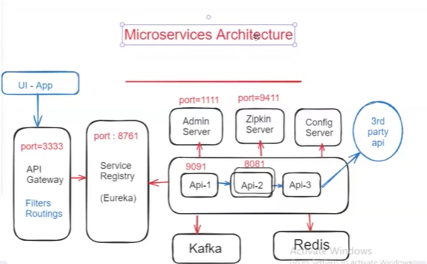
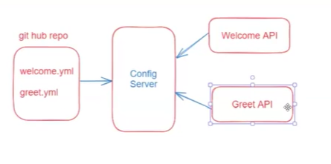
Performance optimization: Package multiple requests for the same API into one.
Response flow: Collect responses from multiple services and send them back to the client as a single response

Slide 6
What is Cloud Config Server
=> We are configuring our application config properties-in- application.properties or application. Yml file
Ex: DB Props, SMTP props, Kafka Props, App Messages etc...
=> application.properties or application. Yml file will be packaged along with our application (it will be part of our app jar file)
=> If we want to make any changes to properties then we have to re-package our application and we have to re-deploy our application.
Note: If any changes required in config properties then We have to repeat the complete project build & deployment which is time-consuming Process
=> To avoid this problem, we have to seperate our project source code and project config properties files.
=>To externalize config properties from the application we can fuse down Spring Cloud Config Server.
Circuit Breaker
It is one of the most famous design pattern in microservices
It is used to implement fault tolerance system /Resilience System.
The Circuit Breaker pattern in microservices acts as a safeguard against service failures by monitoring interactions, setting thresholds, and temporarily halting/Stopping traffic to failing services
Note : If main logic is failed then we need to execute the fallback logic.
Circuit Breaker works based on 3 states
Closed
Open and Half_Open

Slide 7
Circuit Breaker Implementation
1) Create Spring Boot project with below dependencies
a) web-starter
b) actuator
d) resillence4]
c) aop
<dependency>
<groupId>io.github.resilience4j</groupId>
<artifactId>resilience4j-spring-boot3</artifactId>
<version>2.0.2</version>
</dependency>
Circuit breaker Configurations
server:
port: 8081
spring:
application:
name: resilience4j-demo # Corrected application name

Slide 8
management:
endpoints:
web:
exposure:
include: '*' # Expose all actuator endpoints
endpoint:
health:
show-details: always # Always show details in health endpoint
health:
circuitbreakers:
enabled: true # Enable circuit breaker health checks
resilience4j:
circuitbreaker:
configs:
default:
registerHealthIndicator: true
slidingWindowSize: 10
minimumNumberOfCalls: 5
permittedNumberOfCallsInHalfOpenState: 3
automaticTransitionFromOpenToHalfOpenEnabled: true
waitDurationInOpenState: 30s
failureRateThreshold: 50
eventConsumerBufferSize: 10

Slide 9
Apache Kafka
=> It is an open source distributed streaming platform
=> It is used as Message Broker to exchange data among applications.
It is used to process real-time data feeds.
=> It works based on pub-sub model.
1) Publisher =The application which is publishing/produce message to kafka is called as publisher.
2) Subscriber =The application which is reading/consuming message from kafka is called as subscriber.
=> The application which is publishing message to kafka is called as publisher.
The application which is reading message from kafka is
Kafka Architecture
1) Zookeeper
2) Kafka Server
3) Kafka Topic
4) Publisher App
5) Subscriber (Consumer/Listener) called as subscriber.

Slide 10
Apache Kafka Setup In Windows
Step-1 Download Zookeeper from below URL
URL: http://mirrors.estointernet.in/apache/zookeeper/
Step-2: Download Apache Kafka from below URL
URL: http://mirrors.estointernet.in/apache/kafka/
Step-3 Set Path to ZOOKEEPER in Environment variables upto bin folder
### Note: Copy zookeeper.properties and server.properties files from kafka/config folder
to kafka/bin/windows folder. ###
## Step-4 Start Zookeeper server using below command from kafka/bin/windows folder
Command: zookeeper-server-start.bat zookeeper.properties
## Step-5: Start Kafka Server using below command from kafka/bin/windows folder
Command: kafka-server-start.bat server.properties
Note: If kafka server is getting stopped, delete kafka logs from c:/tmp/ folder.
## Step-6 : Create Kafka Topic using below command from kafka/bin/windows folder
Command: >kafka-topics.bat --create --bootstrap-server localhost:9092 --replication-factor 1 --partitions 1 --topic ashokit_topic_1995
## Step-7 View created Topics using below command
Command: kafka-topics.bat --list --bootstrap-server localhost:9092

Slide 11
1) Create Spring Boot application with below dependencies
<dependencies>
<dependency>
<groupId>org.springframework.boot</groupId> <artifactId>spring-boot-starter-web</artifactId>
</dependency>
<dependency>
<groupId>org.apache.kafka</groupId>
<artifactId>kafka-streams</artifactId>
</dependency>
<dependency>
<groupId>org.springframework.kafka</groupId>
<artifactId>spring-kafka</artifactId>
</dependency>
<dependency>
<groupId>com.fasterxml.jackson.core</groupId> <artifactId>jackson-databind</artifactId>
</dependency>
<dependency>
<groupId>org.springframework.boot</groupId> <artifactId>spring-boot-starter-test</artifactId>
<scope>test</scope>
</dependency>

Slide 12
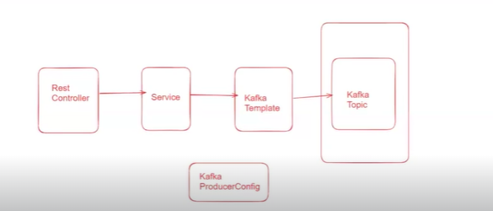
<dependency>
<groupId>org.springframework.kafka</groupId>
<artifactId>spring-kafka-test</artifactId>
<scope>test</scope>
</dependency>
</dependencies>
Kafka Producer Application Architecture
Kafka ProducerConfig will have key value

Slide 13
Consumer configuration
<dependencies>
<!-- Spring Boot Starter Web -->
<dependency>
<groupId>org.springframework.boot</groupId>
<artifactId>spring-boot-starter-web</artifactId>
<version>3.1.2</version> <!-- Add the correct version -->
</dependency>
<!-- Kafka Streams -->
<dependency>
<groupId>org.apache.kafka</groupId>
<artifactId>kafka-streams</artifactId>
<version>3.4.0</version> <!-- Add the correct version -->
</dependency>
<!-- Spring Kafka -->
<dependency>
<groupId>org.springframework.kafka</groupId>
<artifactId>spring-kafka</artifactId>
<version>2.9.6</version> <!-- Add the correct version -->
</dependency>
<!-- Jackson Databind -->
<dependency>
<groupId>org.springframework.boot</groupId>
<artifactId>spring-boot-starter-test</artifactId>
<version>3.1.2</version> <!-- Add the correct version -->
</dependency>
</dependencies>

Slide 14
5) Add below method in boot app start class
@KafkaListener(topics = AppConstants. TOPIC, groupId="group_ashokit_order")
public void subscribeMsg(String order) {
System.out.print("*** Msg Recieved From Kafka *** . : : - ");
System.out.println(order);
//logic }
To Reduce no of calls from database we use kafka
Redis Cache
Redis is built to this task: It stores all data in-memory—delivering the fastest possible performance when reading or writing data—and offers built-in replication capabilities that let you place data physically closer to the user for the lowest latency.
=> 2 types of tables
1) Transnational tables CRUD opérations
2) Non- Transnational Tables
Cache : we use for temporary database
<dependency>
<groupId>org.springframework.boot</groupId>
<artifactId>spring-boot-starter-data-redis</artifactId>
</dependency>
<dependency>
<groupId>redis.clients</groupId>
<artifactId>jedis</artifactId>
</dependency>

